Slide 1

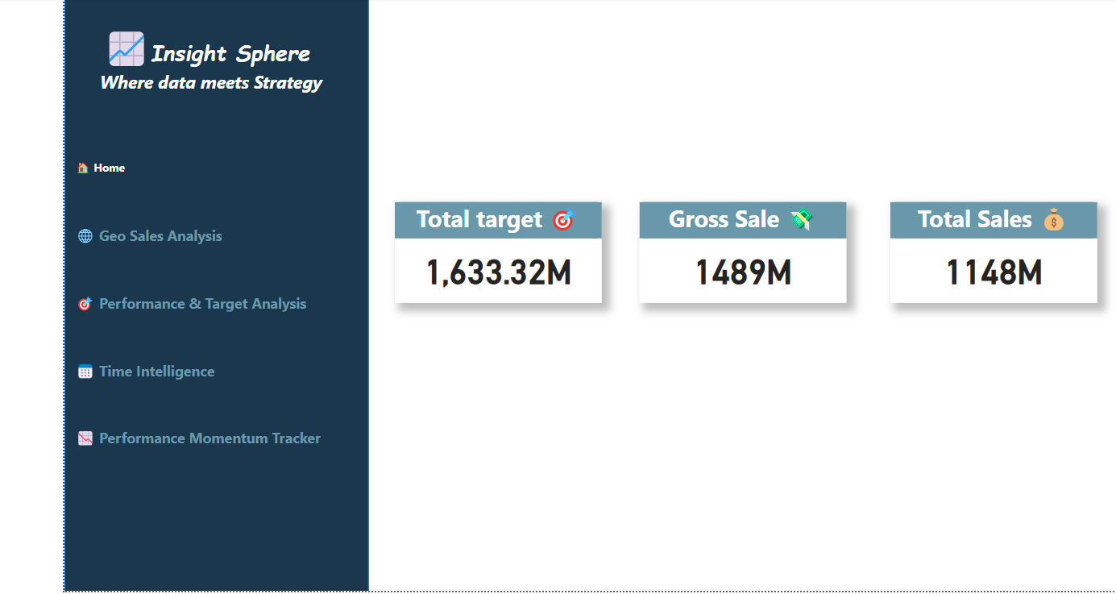

Slide 2
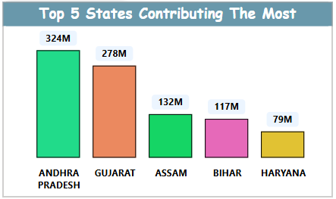
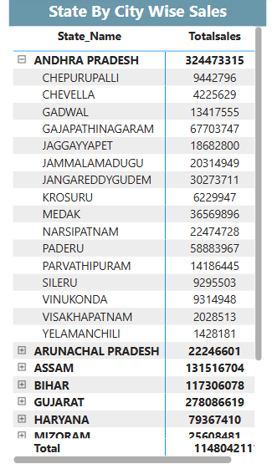
Business Scenario -1 :-
Which state contributes the highest total revenue?
How do sales vary across cities within a particular state?
Among all the operational regions, the top 5 states significantly drive the overall sales performance. These states collectively contribute the majority share of revenue, highlighting key market strongholds and offering opportunities for strategic focus and resource allocation.
Within each state, city-level performance varies significantly. This chart highlights key cities driving revenue, helping identify local strengths and untapped opportunities.

Slide 3
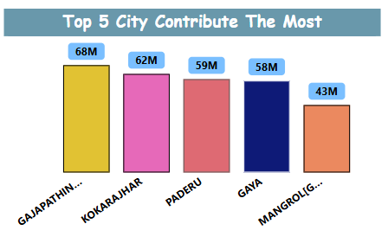
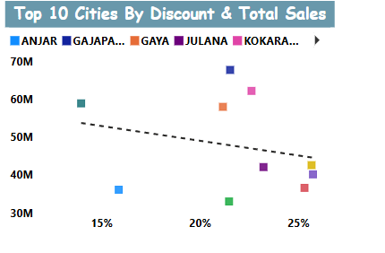
Business Scenario 2 :-
Which top 5 cities contribute most to the business revenue?
Are there any underperforming cities compared to their state average?
These 5 cities are the real revenue drivers of the business. Their strong performance stands out compared to others, making them key markets for strategic investment and continued growth. They offer great benchmarks for expanding success across less-performing cities.
This visual maps total sales against discount percentages for the top 10 cities. Ideally, higher discounts should correspond to increased sales. However, we observe certain cities offering steeper discounts but not yielding proportional sales volume — a sign of underperformance relative to investment. This opens up opportunities to reevaluate discount strategies or marketing efforts in those regions.

Slide 4
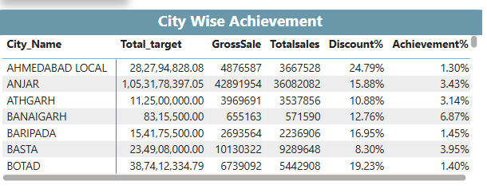
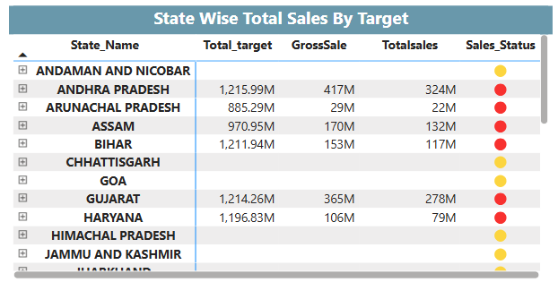
Business Scenario 3:-
Are discount patterns affecting target achievements?
Which states are achieving or exceeding their sales targets?
The table highlights city-wise performance by comparing total targets, sales, discounts, and achievement percentages. Interestingly, cities offering higher discounts like Ahmedabad Local (24.79%) and Botad (19.23%) are still showing very low achievement rates — just 1.3% and 1.4% respectively. This suggests that simply increasing discounts is not effectively driving target achievement. On the contrary, cities like Banaigarh and Basta, with relatively modest discounts, are achieving better efficiency. This indicates a potential misalignment between discount strategy and consumer response, signaling a need for more targeted promotions or localized marketing approaches.
The visual presents a comparative overview of total sales vs targets across multiple states. States like Andaman and Nicobar, Chhattisgarh, Goa, and Himachal Pradesh are shown with yellow indicators, suggesting they are performing near target or showing stable growth. However, several key states such as Andhra Pradesh, Assam, Bihar, Haryana, and Arunachal Pradesh are underperforming, as indicated by the red status dots. Their total sales remain significantly below the target despite having considerable gross sales. This reveals performance gaps, emphasizing the need to investigate regional market challenges, optimize local strategies, or evaluate supply chain and promotional effectiveness in the red-marked states.

Slide 5
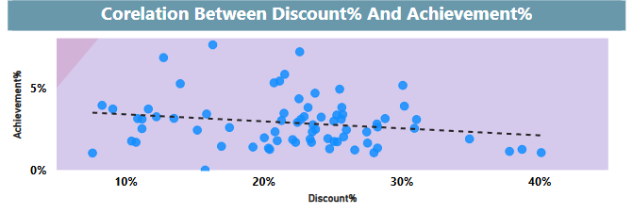
Business Scenario 4 :-
What is the correlation between discount % and target achievement?
The scatter plot visual highlights a slightly negative correlation between Discount % and Achievement %. As discounts increase beyond the 20–25% range, the target achievement % tends to decline for most cities.
Despite higher discounts aimed at boosting sales, the achievement percentage often remains below 5%, suggesting that aggressive discounting does not guarantee better performance against targets. In fact, it may be counterproductive, hinting at issues such as:
Unsustainable pricing strategies,
Target setting misalignment,
Or customer segments less responsive to discounts.

Slide 6
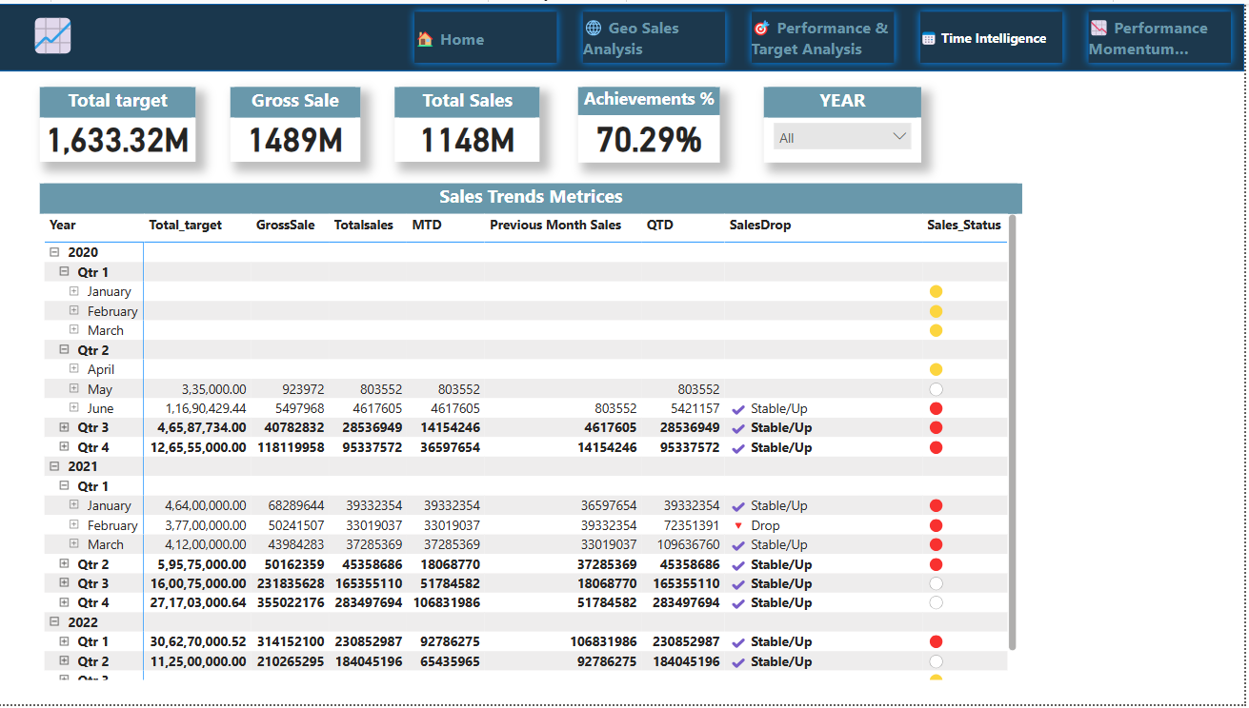
Business Scenario 5 :-
How are sales performing month-to-date (MTD),
quarter-to-date (QTD), and year-to-date (YTD)?
The dashboard illustrates how the organization is tracking performance over time — capturing insights at monthly (MTD), quarterly (QTD), and yearly (YTD) levels.
MTD (Month-to-Date): Performance varies each month with noticeable surges in key months like March 2021, which saw significant MTD sales of ₹37.28M, contributing to a strong Q1 finish. However, months like April 2020 recorded only ₹803K, showing weak starts that potentially impacted quarterly goals.
QTD (Quarter-to-Date): The most robust QTD figure comes from Q4 2020, where the company recorded over ₹95.33M in QTD sales, indicating an aggressive end-of-year push. Consistently improving QTD in 2021 reflects stable or upward momentum quarter-over-quarter.
YTD (Year-to-Date): Although not explicitly shown in the dashboard, cumulative QTD values across all quarters paint the YTD picture. With Total Sales at ₹1148M and Target at ₹1633.32M, the company has achieved ~70.29% of its yearly goal, suggesting scope for improvement as the year closes.
📈 Status Indicators: Color-coded status icons show sales trend consistency:
✅ Stable/Up: Majority of quarters and months in 2021 and 2022 are showing stable/upward trends.
⚠️ Drop: February 2021 showed a dip, requiring deeper investigation into performance issues.

Slide 7
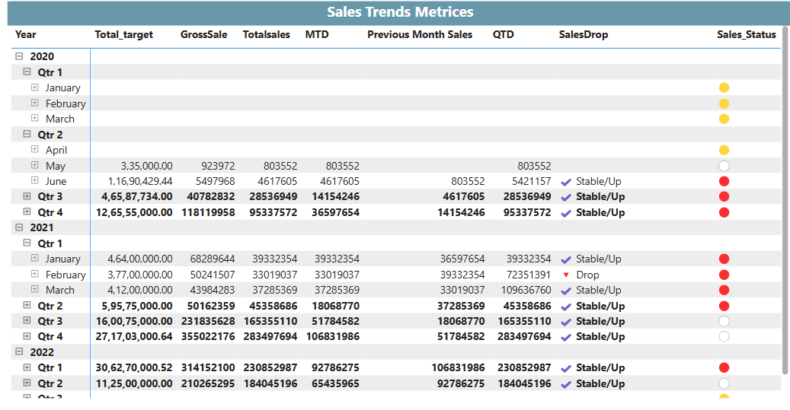
Business Scenario 5 :-
Are there any seasonal patterns noticeable?
Insights from the Chart:
Strong Q4 Performance:
In 2020 Q4, the sales spiked with Total Sales at ₹95.33M, which is significantly higher than other quarters.
This trend repeated in 2021 Q4 with ₹28.34M, and while not as high as 2020, it still shows a year-end push, possibly due to festive seasons or annual targets.
Consistent Drops in Q1/Q2:
Q1 of both 2020 and 2021 shows relatively lower performance, especially April & May. For example:
April 2020 only had ₹803K in sales, the lowest in the dataset.
This might suggest a slow season post year-end sales, or possibly external factors (e.g., financial year start, less demand).
Recovery and Growth in Q3:
In 2021 Q3, sales grew to over ₹45.31M, a significant jump — hinting that mid-year strategies or campaigns could be driving momentum.

Slide 8
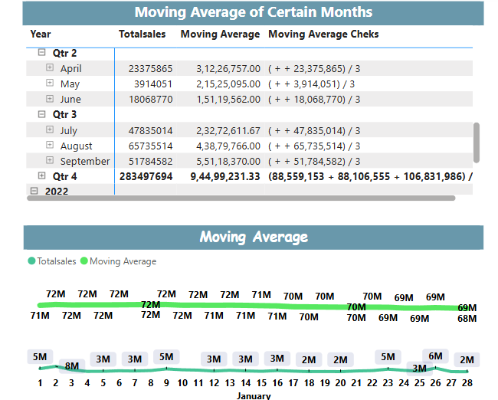
Business Scenario 6 :-
What is the 3-month rolling average of sales for each city or state?
Q2 2021 (Apr - Jun):
Sales totals were modest but showed progressive recovery.
April: ₹2.33 Cr
May: ₹39.14 L
June: ₹1.80 Cr
Moving Average remained under ₹3.12 Cr—indicating a sluggish period, likely due to post-pandemic effects or seasonal slowness.
Q3 2021 (Jul - Sep):
This quarter marked a clear upswing in performance:
July: ₹4.78 Cr
August: ₹6.57 Cr
September: ₹5.17 Cr
Rolling averages increased significantly:
Peaked at ₹5.51 Cr in Sep, indicating strong sales momentum and possibly seasonal demand (e.g., pre-festive or back-to-school periods).
Q4 2021 Summary:
The combined Q4 moving average hit ₹9.44 Cr, the highest across the year, driven by consistent growth in Q3 months.
Suggests that sales cycles build up during Q2–Q3, peaking in Q4, potentially due to fiscal closeouts or festive spending.

Slide 9
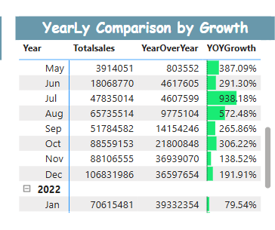
Business Scenario 6 :-
How has the business grown compared to last year’s performance?
Compared to 2020, 2021 was a comeback year. With quarterly sales more than doubling in Q2 and Q3, the business showed resilience and agility. Stronger planning and increased demand helped us achieve 70.29% of our sales target. The year-over-year growth is especially visible in Q2 and Q4, signaling recovery from the pandemic slump and entry into a phase of sustained growth.
Recommendations:
Replicate Q2–Q4 strategies across all regions for the next year.
Focus on improving performance in Q1, where achievement still lags.

Slide 10
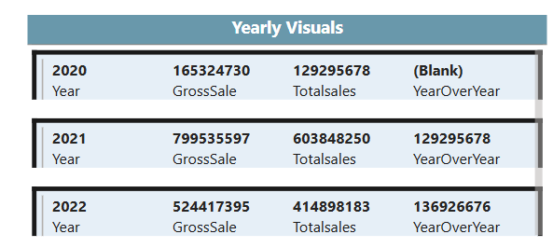
Business Scenario 7:-
Are we trending upward or downward in terms of YoY metrics?
Based on year-over-year analysis, the business is trending upward. From the post-COVID recovery in mid-2020 to strong gains in Q2 and Q4 of 2021, and a promising start in 2022, each successive year is outperforming the last. Sales figures and moving averages both support a trajectory of steady growth and resilience. Yes, we are trending upward in terms of YoY sales performance.

Slide 11

Thank You

